Slide 1

Smart Medical System

Slide 2
In this presentation, an overview of the project
-SOMEONE FAMOUS

Slide 3
Project Abstract
1- This project aims to provide all possible means to help patients in the most difficult and most dangerous situations.
2- As part of the project's tasks is to call all the data which is necessary to start dealing with the injured "the patient" where we provide the data.
3- And time, which is a very important factor in emergency . situations, in addition to the electronic prescription to avoid any possible errors.
4- In the past years, many projects have been implemented that facilitate many operations in the hospital, such as administrative transactions, warehouse management, and information about patients who visited the hospital. One of the defects of these programs is that they are limited to one thing only, and these programs require a person to deal with them, which increases the cost of salaries.
5- This project will make a big difference in the field of medicine and hospitals

Slide 4
01
02
Hardware
Software
03
04
Database Center
Control center
Parts of Project
Fingerprint sensor and electronic chips
Fully functional system works on android, windows
A database in which all data is recorded
hospital control center

Slide 5
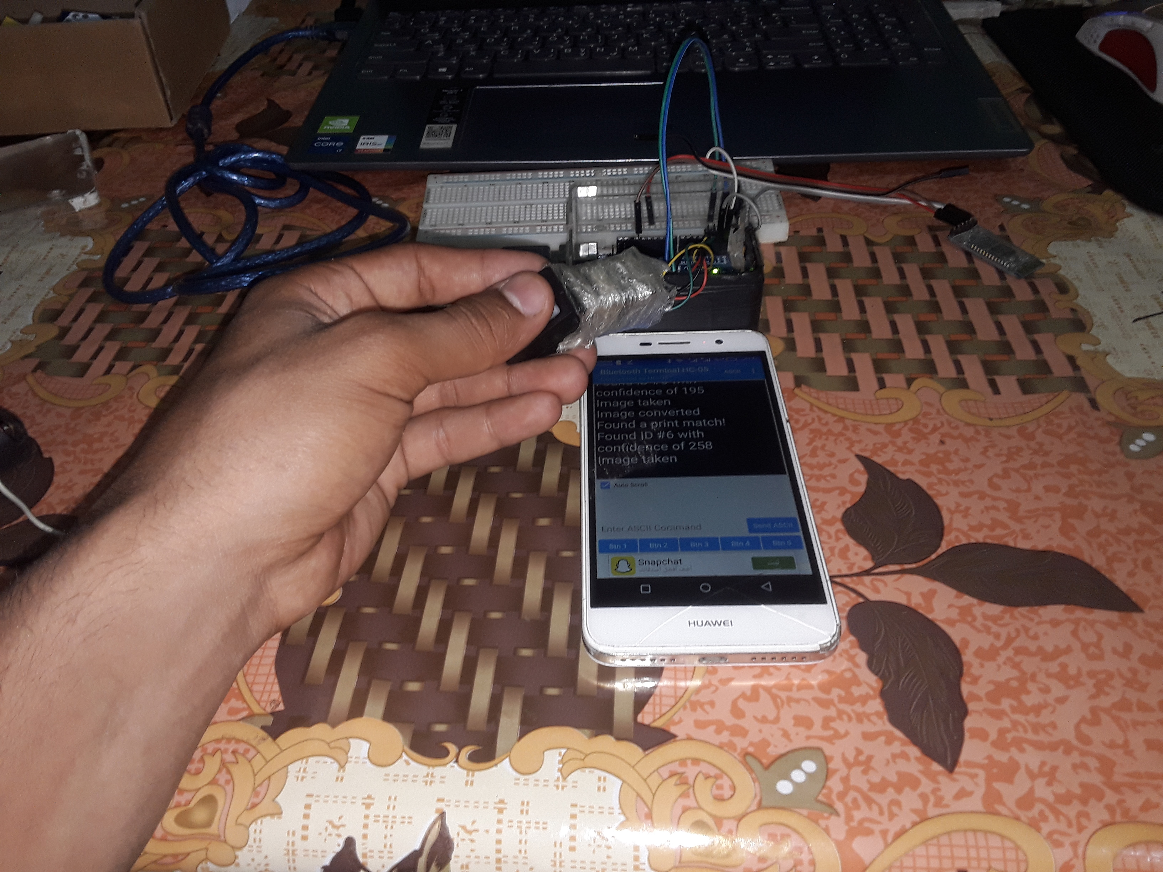
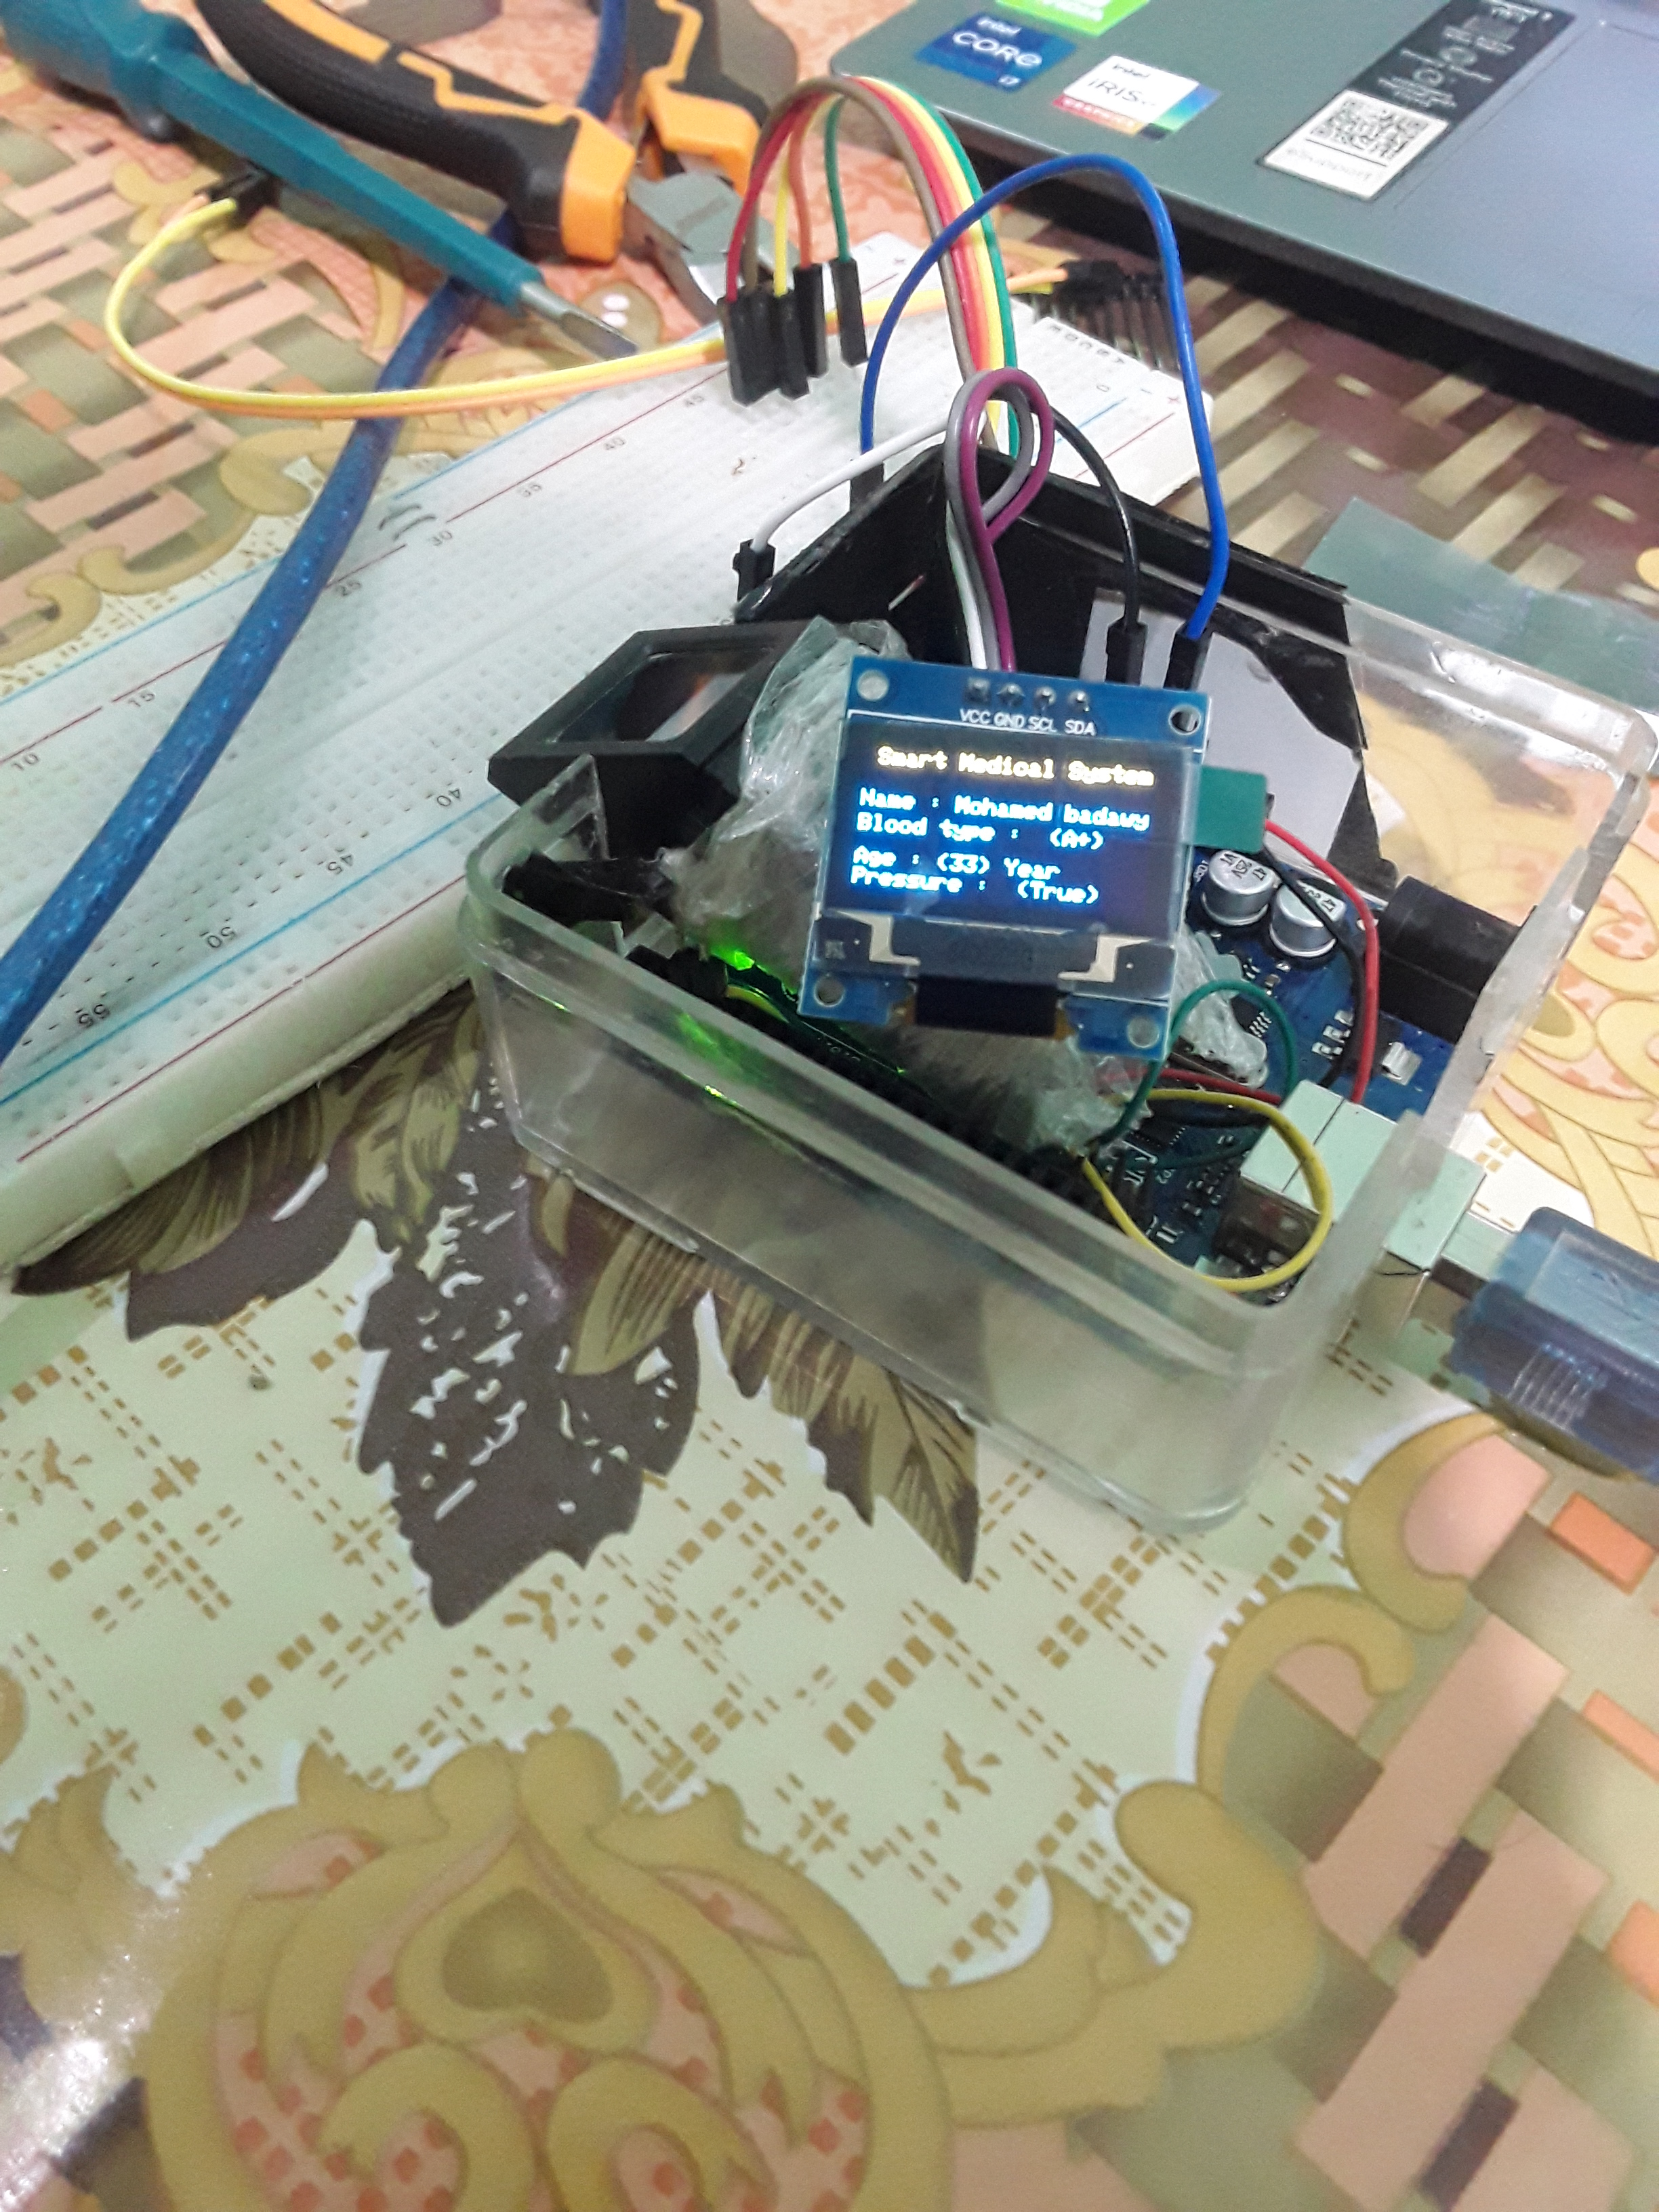
version 1.

Slide 6
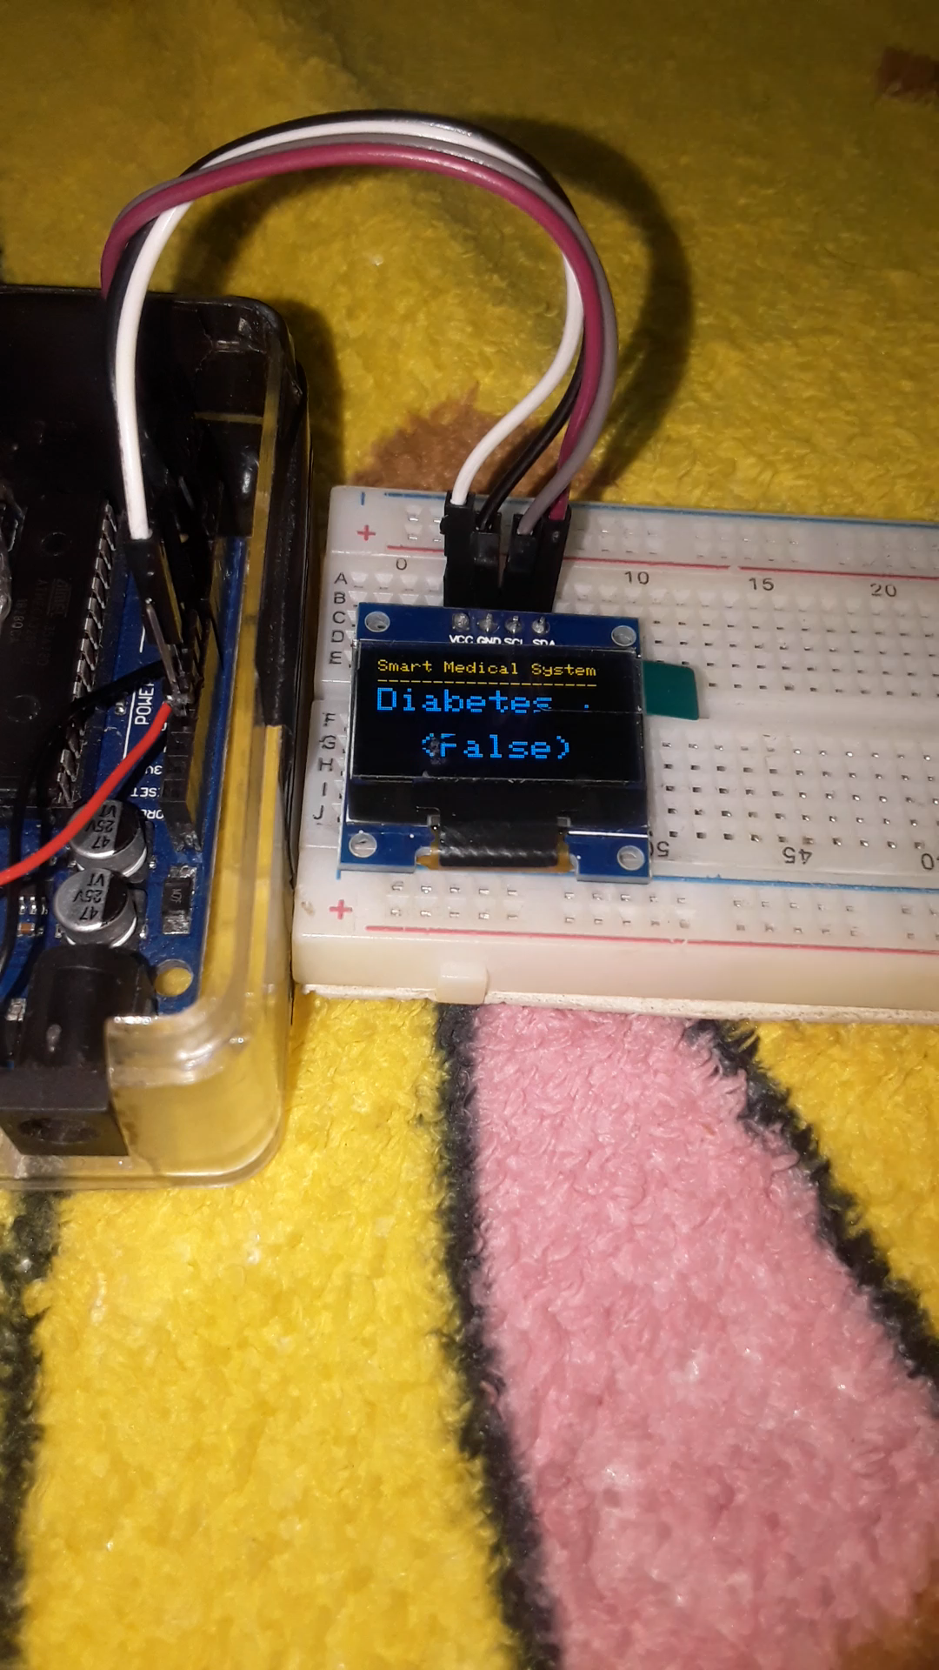
Display

Slide 7
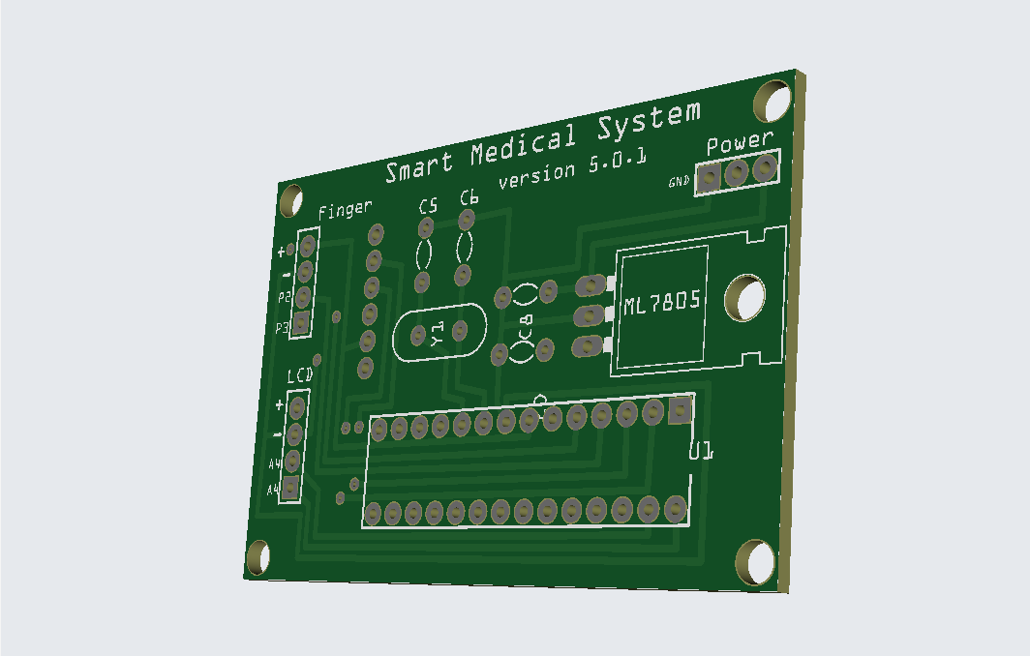
PCB Board

Slide 8
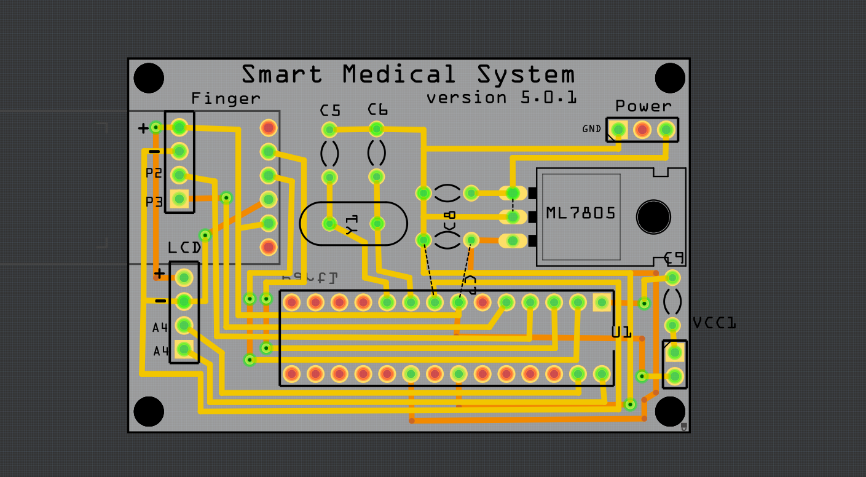
PCB Board

Slide 9
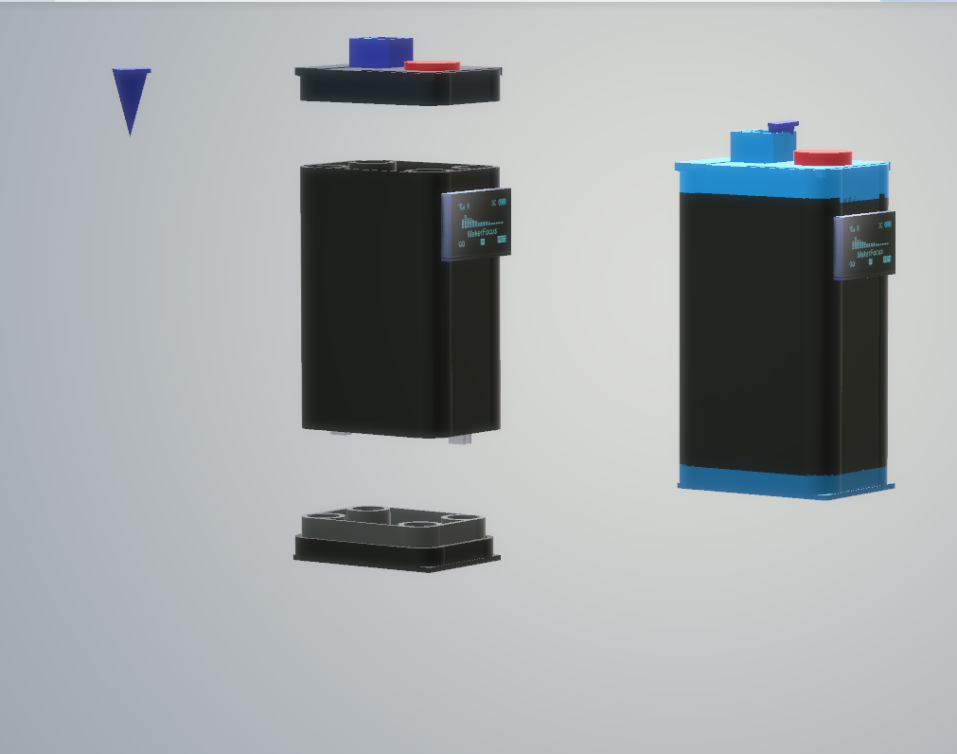
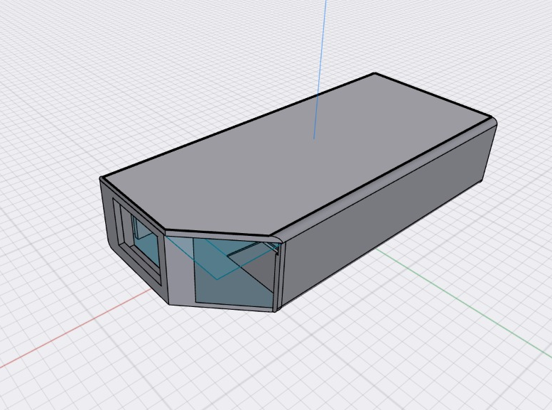
3D
Version 1
Verison 2

Slide 10
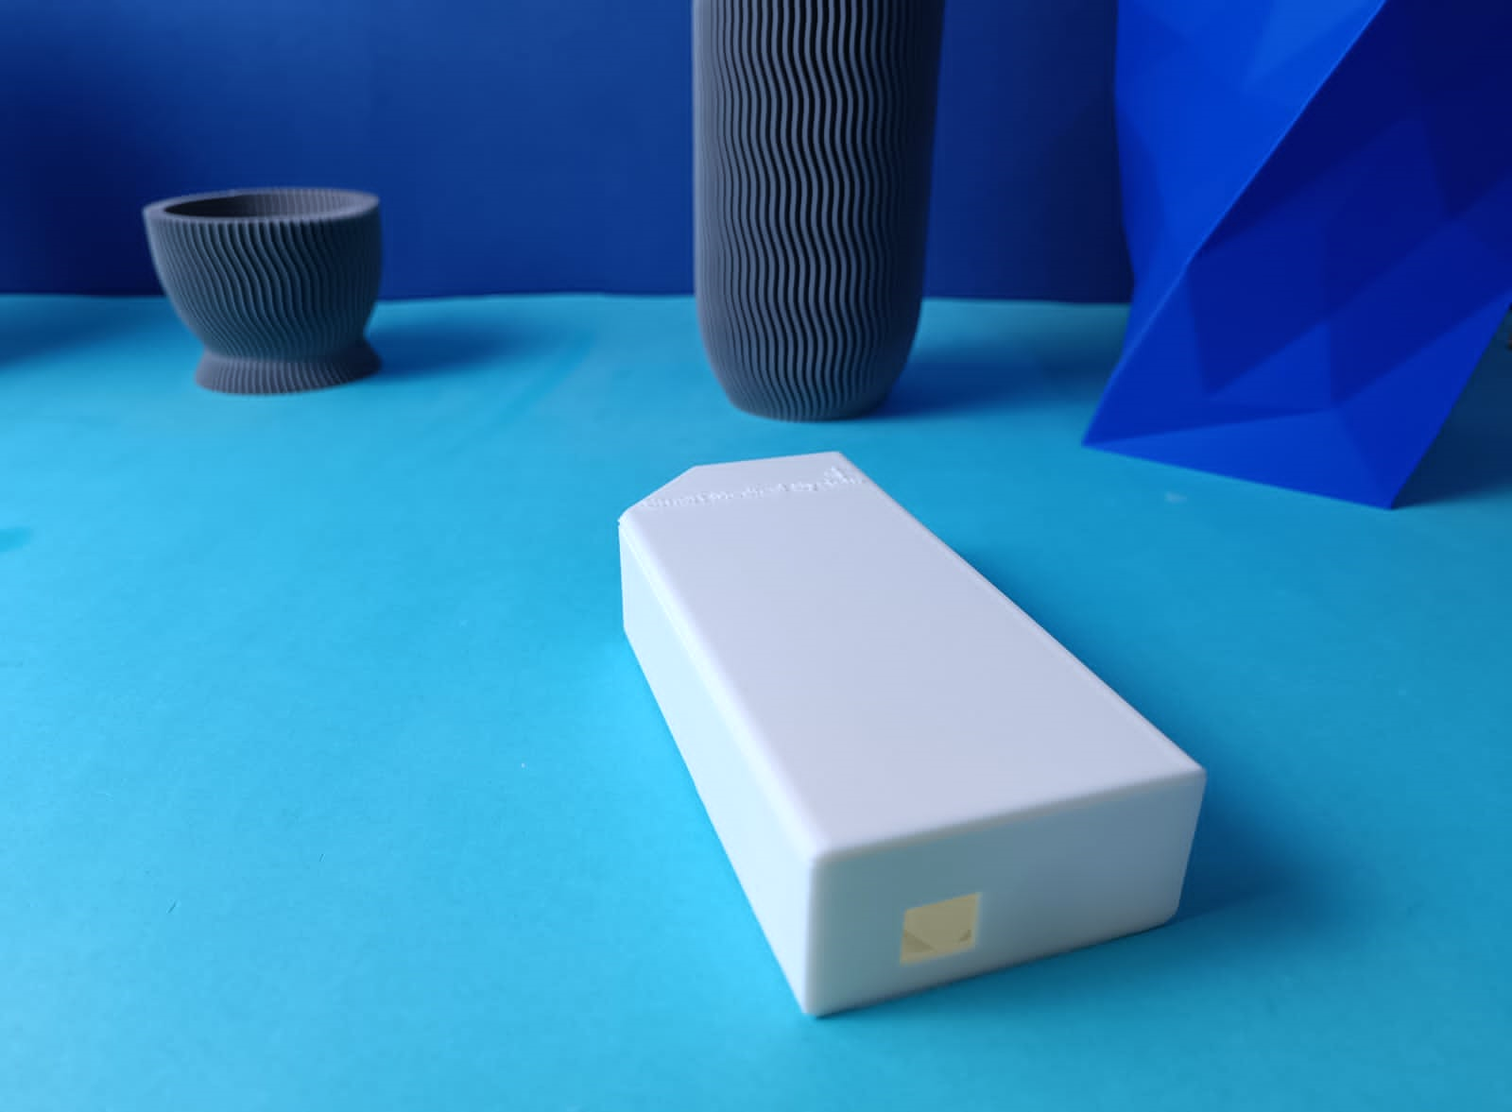
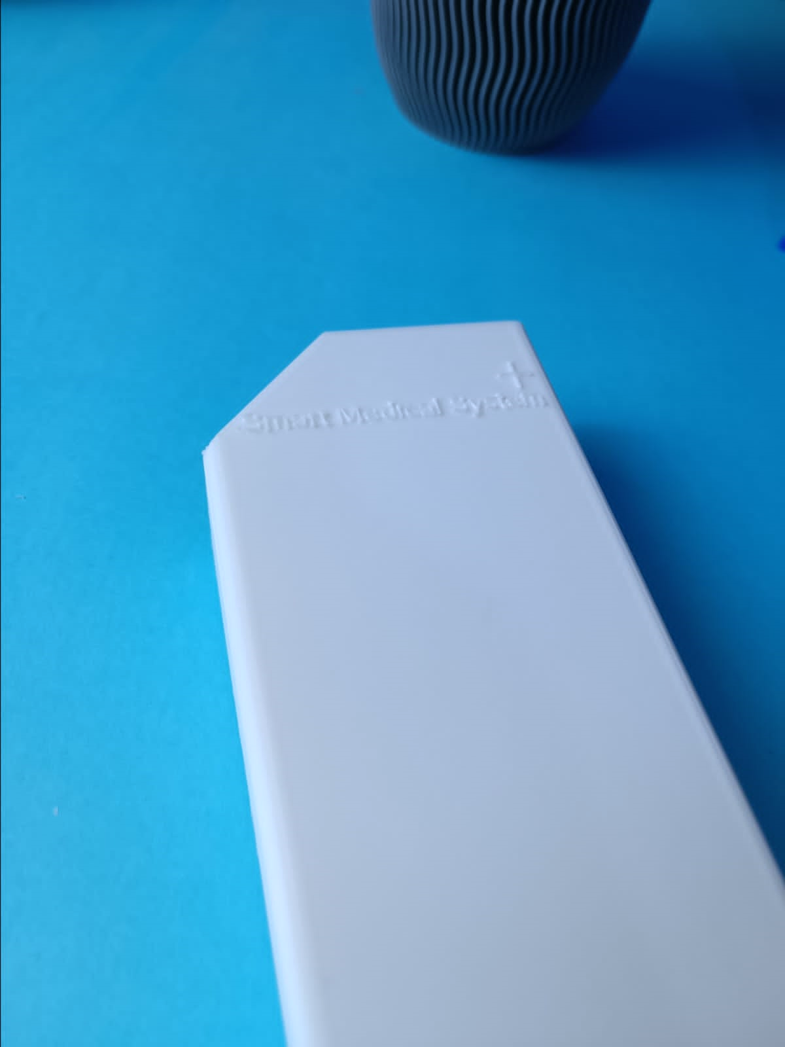
3D Final
Version 2

Slide 11
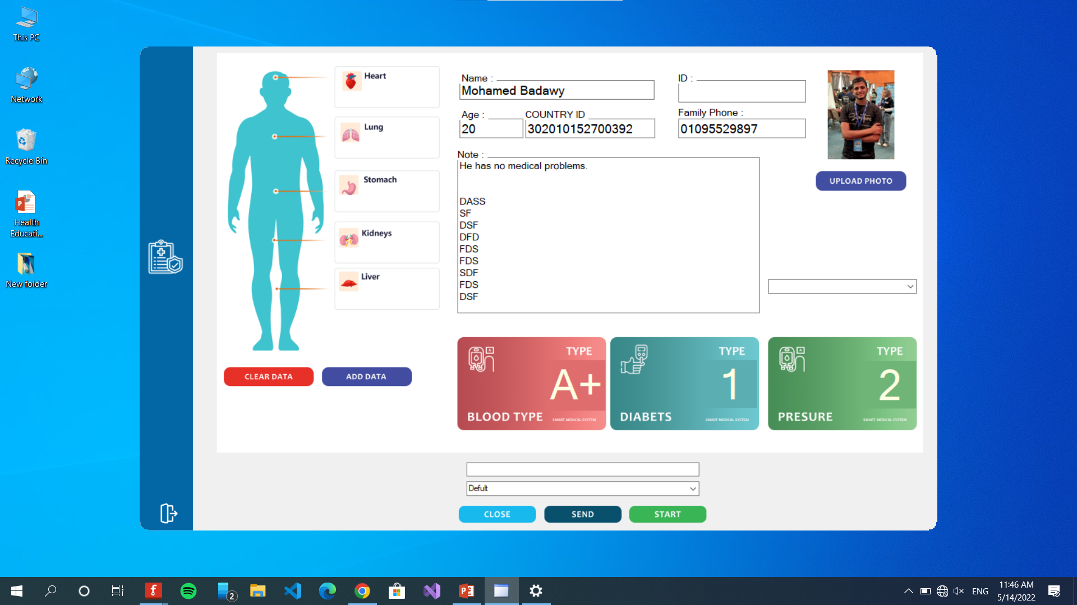

Desktop

Slide 12
Future
Plans
-SOMEONE FAMOUS

Slide 13

prescription

Slide 14
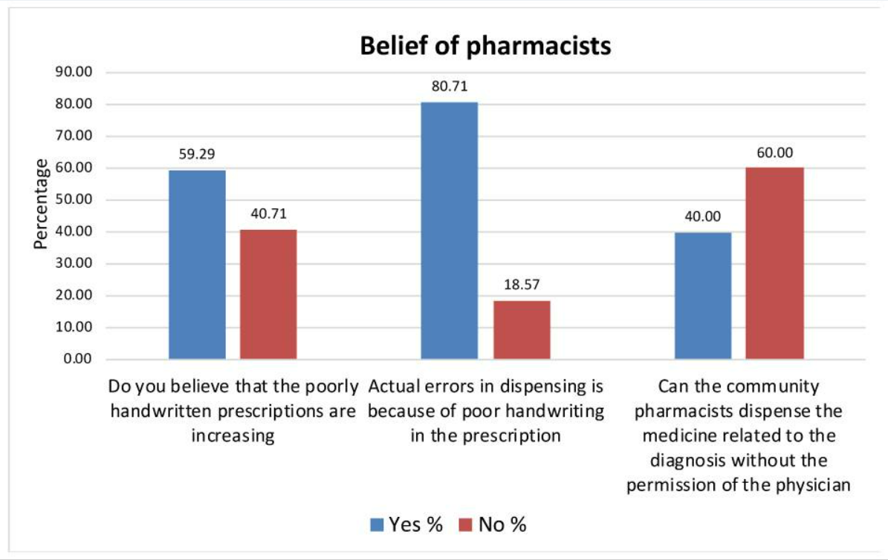
How the prescription relates?
While the phase of ideation and researching we come over across the problem of bad handwriting in India, Canada, Germany, USA, and Saudi Arabia, etc.
So we take it as a side idea to do more research as it’s related to the industry that we are trying to develop. Also, as it’s shown on the graph according to Saudi Arabia pharmacists’ community.
reference

Slide 15
+ 120,360
HOW MANY PEOPLE SUFFERING FROM THE BAD HAND WRITING YEARLY

Slide 16
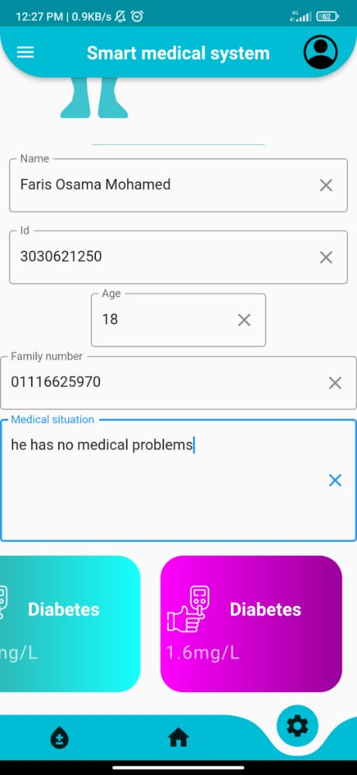
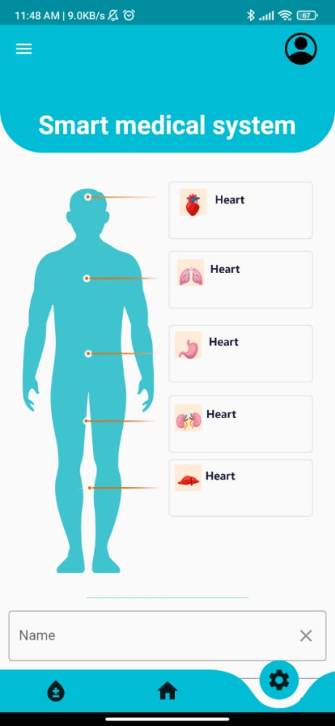
Mobile Web
You can replace the image on the screen with your own work. Just delete this one, add yours and then center it properly

